Slide 1
First JCL Meeting!
Room 313
Notes:
Welcome- carly

Slide 2
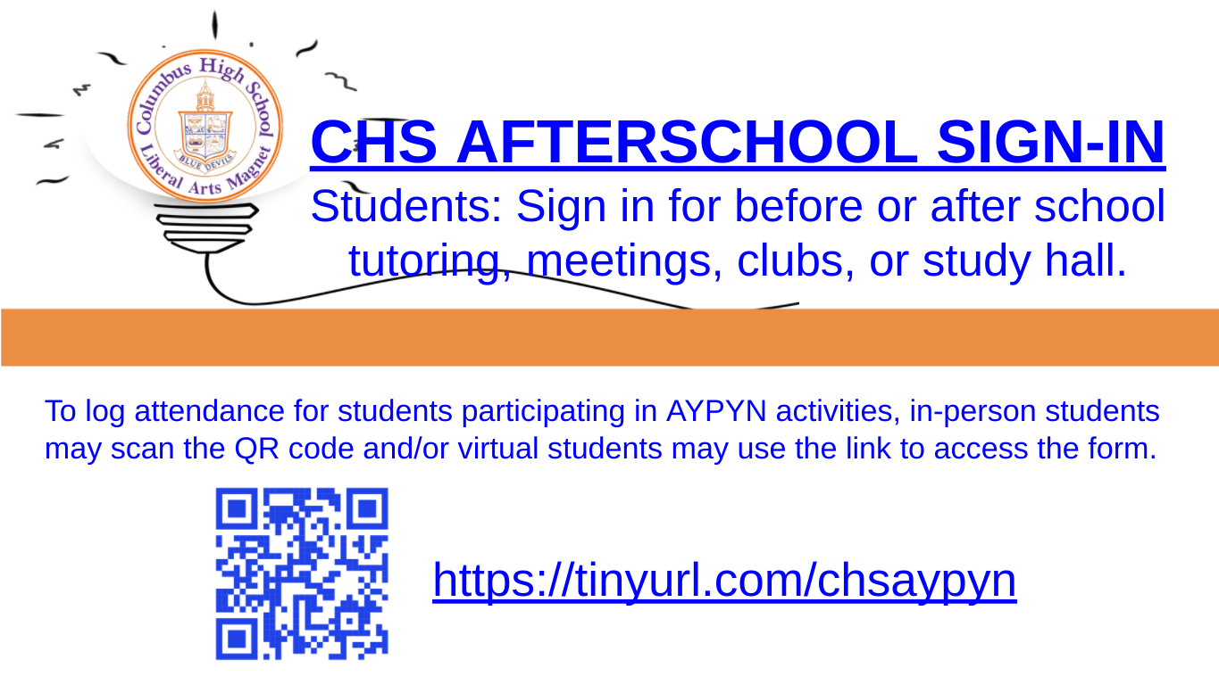
MUST DO BEFORE YOU LEAVE
Notes:
Apyn- lucas

Slide 3
This Year’s Officers
Carly Smith- President
Lucas Laymon- 1st Vice President
Lauren Cruickshank- 2nd Vice President
Secretary- Julia Gogas
Co-Editors- Nicki Howard and Shruthi Sankar
For questions see Carly Smith or Julia Gogas either in person or via email
Alternatively, ask your question in the GroupMe or chsclassics@gmail.com
Notes:
Big voice person to hype officers up: Lucas? Everyone should do a little wave, but maybe not introduce ourselves just yet
Can we just say contact one of your officers or email chsclassics@gmail.com, which we all answer?

Slide 4
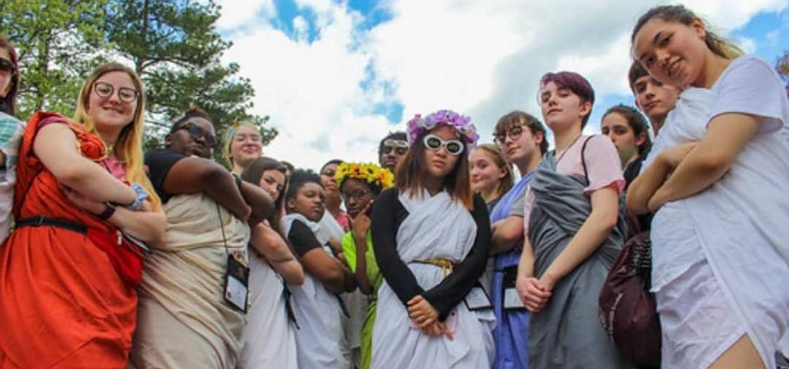
“What is JCL?”
“Latin Club”- An open and diverse group of friends who celebrate each other through wins and losses
WE CELEBRATE EVERY VICTORY, NO MATTER HOW SMALL
Community
Monthly meetings
Social events
GJCL
Testing
Tutoring
Notes:
Lauren

Slide 5
Community
Notes:
Julia

Slide 6
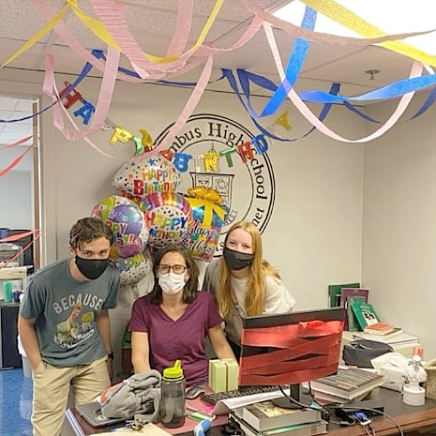
The Latin Cult
Look out for each other
Empathize
Building friendships
Notes:
Julia

Slide 7
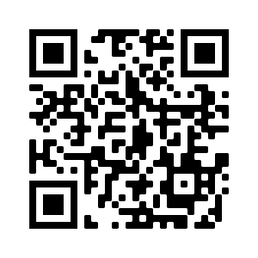
GroupMe- optional to join
Notes:
Julia

Slide 8
Get in touch:
chsclassics@gmail.com
IG: bluedevils.jcl
Website: www.chsclassics.wixsite.com/website
Notes:
Julia
Please really push the website, I want people to know that it is a consolidated info source

Slide 9

Meetings
Notes:
Carly

Slide 10
Meetings-First Friday of the Month
At the end of the meeting a sheet will be passed out with all the dates for the first semester
Reminders will be sent via:
  Mr. Rosa’s room
  Through the GroupMe
  Through the emails on the sign up list (see Julia)
  Posts on the Instagram
  All meetings are on the school calendar, but check our website for most updated notifications
Notes:
Carly

Slide 11
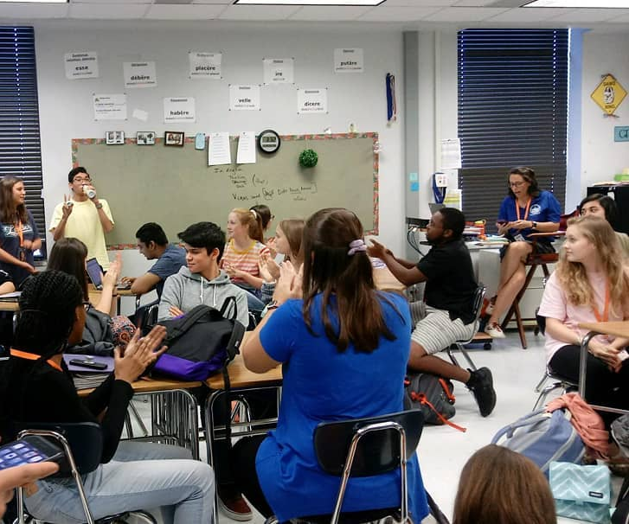
Next Meeting: October 1
October Event Information
October 16 Social Event
Fall Forum?
Club Dues & Testing
Tee Shirt Competition
Rules
Notes:
Carly
We’re gonna need to address testing bc registration is due in october

Slide 12

T-shirts
Designs must be submitted by 3rd meeting (November 5th)
Winner will receive a prize (there may or may not be a T shirt with your name on it!)
Cost will be separate from dues
  Price TBD
Notes:
Lucas

Slide 13

Design Contest Rules
Stick to no more than 4 colors
  Preferably 3, but 4 if you deem it necessary to orchestrate your vision
Must have CHS JCL 2021-2022
Must include this year’s theme

Slide 14
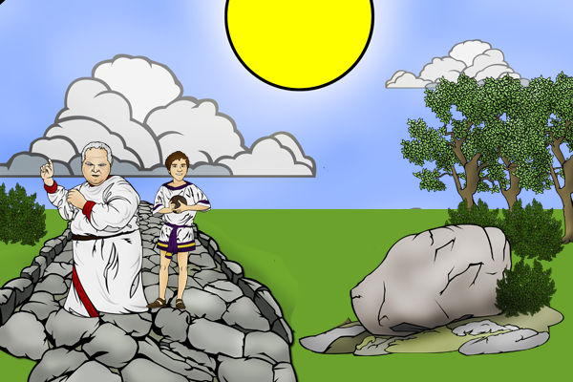
Theme for the Year:
NJCL-
"Cantantes licet usque eamus--minus via laedt,"
(Let us go singing as far as we go--the road will be less tedious.)
Notes:
Carly

Slide 15
Dues
$10
Will be open on MyPaymentsPlus October 1st through the 31st
Pays for state and national membership fees
Leaves a small fund for social events and fees
Separate Testing Dues-- fall test dues due Oct. 1
Notes:
Lucas
I talked to Hood and she said she just always inflated to 10$ and thinks that’s the most reasonable amount. I like the evenness, it’s easy to remember

Slide 16
Events Schedule
Notes:
Lauren

Slide 17
Social Events- optional, but very fun
September, 25th- Picnic at Flatrock park
October 16th- Spookie SZN Mythology based costume contest
November 13th- Outdoor movie night
December 18th- Saturnalia celebration
Notes:
Lauren

Slide 18
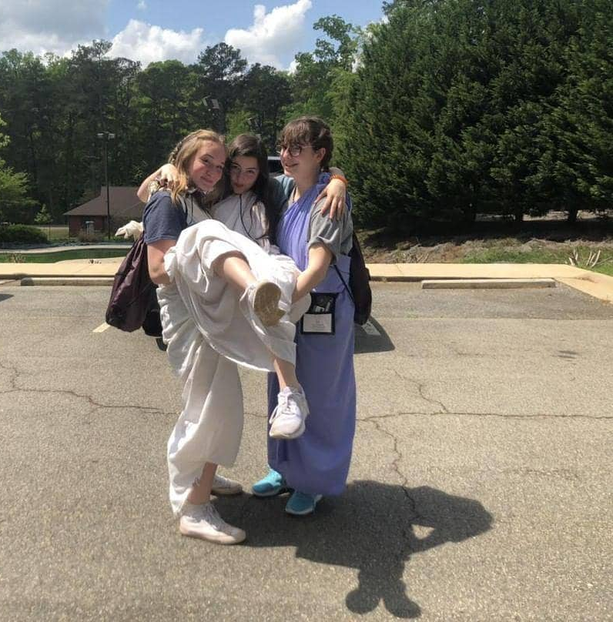
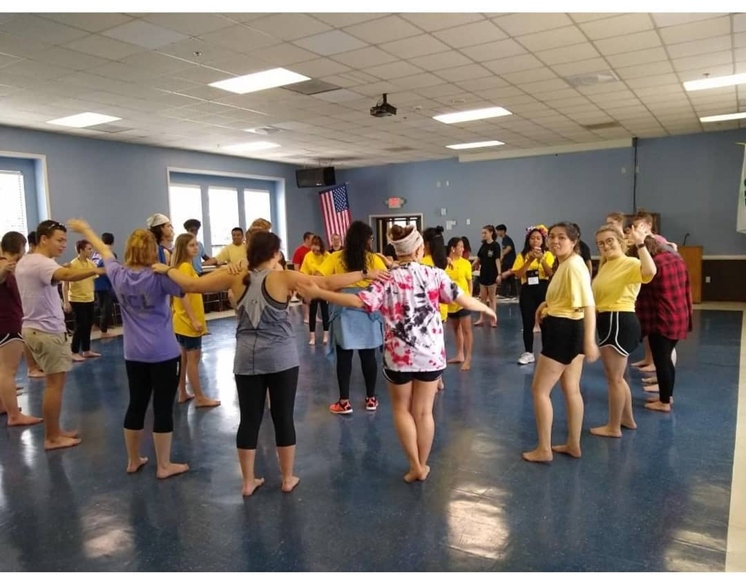
GJCL
Fall Forum
State Convention
Notes:
Nicki

Slide 19
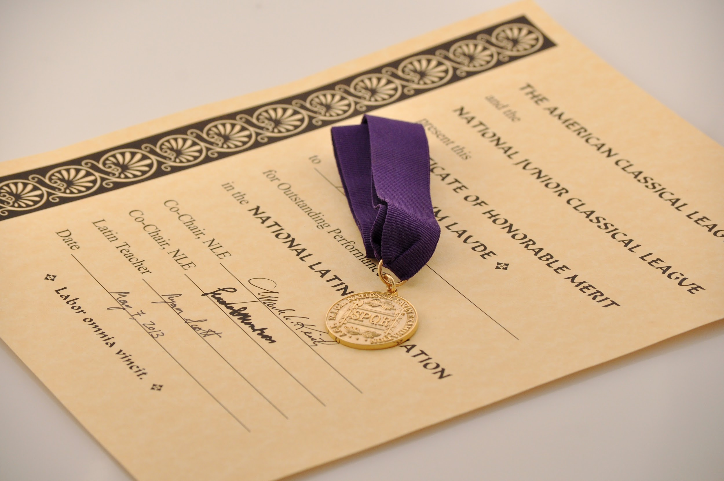
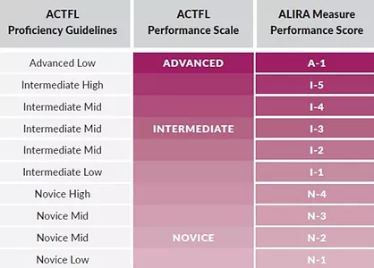
NJCL & Testing
Fall Exams- 5$ each
  National Classical Etymology Exam (NCEE)
  National Roman Civilization Exam (NRCE)
Spring Exams
  ALIRA Test 10$
  National Latin Exam 6$
  National Latin Vocabulary Exam (NLVE)
  National Hellenic Civilization Exam (NHCE)
Notes:
Nicki

Slide 20
Peer Tutoring
Notes:
Nicki

Slide 21
NEW THIS YEAR! NLHS Partnership
Every Friday without a pep rally, Latin people will post up in here, no appointments necessary
Sign Ups to tutor are on the website under “Peer Tutoring”
Schedule:
September 10
October 22
November 12
December 10
Notes:
Nicki

Slide 22

If you want to be featured...
Send pictures to shruthi to be featured on the website or instagram or stop over and get her to take your snapshot
Notes:
Shruthi

Slide 23
Final notes
If you would like the presentation to reference contact us in one of the aforementioned ways
Not every meeting will have a presentation, but Julia will always take the minutes so refer to her if you need the meeting contents
Going to every meeting is not mandatory to stay in the club
Other questions?

